Slide 1

Artificial intelligence and machine learning
shAIForAI

Slide 2
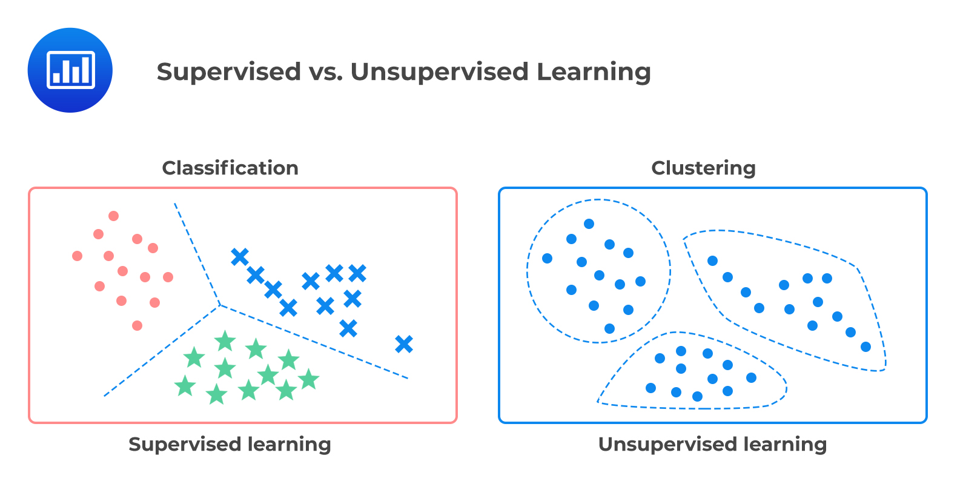

Slide 3
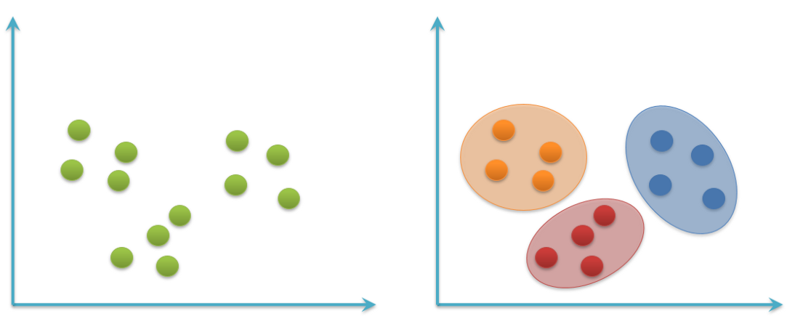
What is Clustering?
Dividing the data points into groups
Data points that are in the same group should have similar properties
While data points in different groups should have different properties
Finding a Structure within the collection of data
Unsupervised Learning Technique
Notes:
dividing the data points into groups and each group consist of similar data points
instead of learning from training dataset(as in supervised learning), here model itself find hidden patterns and insights from the data. It create groups based on some similarity even without knowing what each group represent.

Slide 4
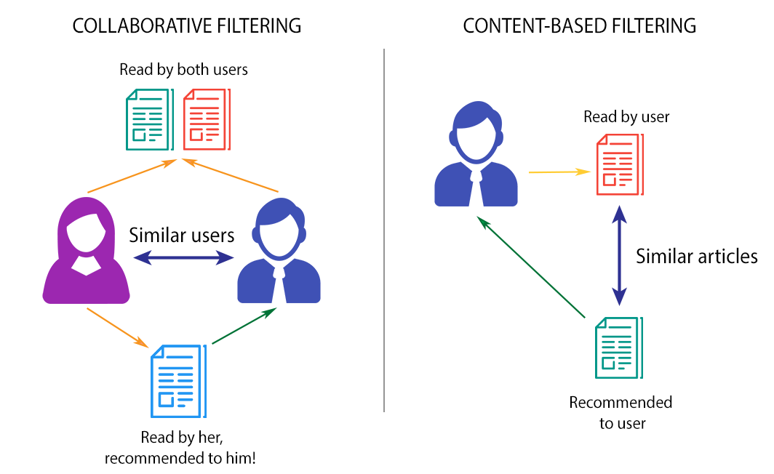
Scenario

Slide 5
Applications
Medical research
Customer Segmentation
Marketing
Recommendation Systems
Document clustering
Notes:
Healthcare / Medical research — In this field, clustering helps to classify the patients based on their symptoms, pathological tests scores, CT Scans, MRI scans, X-ray reports, etc. and study the application of specific lines of treatment for various clusters and standardize the treatment procedures for different clusters.
The clustering method provided an idea of like-minded users. The computation/estimation as data provided by several users is leveraged for improving the performance of collaborative filtering methods. And this can be implemented for rendering recommendations in diverse applications.
determines which documents are related to each other, and groups them into clusters. Clustering makes it easy to explore and categorize “big data” sets of documents, bringing efficiency to the electronic discovery process.

Slide 6
Clustering Algorithms
Partitional Clustering
K-means, K-mediods
Hierarchical Clustering
Agglomerative algorithm
Divisive algorithm
Density-based clustering
DBSCAN, OPTICS, Meanshift
Distribution-based clustering
Expectation Maximization algorithm
Notes:
Unlike k-means, the k-medoids select actual observations from the data as the center of the cluster.
Density-based clustering: In this method, the observations are grouped together based on density of points that are closely packed. DBSCAN and OPTICS are two popular density-based algorithms
Distribution-based clustering: In this method, the observations are grouped based on the distribution models and observations in the same cluster are most likely coming from the same distribution. Gaussian mixture algorithm is an example of Distribution-based clustering
Gaussian mixture models are solved using the Expectation Maximization algorithm and the probability of each observation belonging to k- clusters is computed.
the model does not take into account the variance of the data (width of the bell shaped curve). The variance of the data determines the shape of the cluster.
K-means distributions work well when the shape of the clusters is circular, however for oblong shaped clusters, Gaussian distribution clustering works very well.

Slide 7
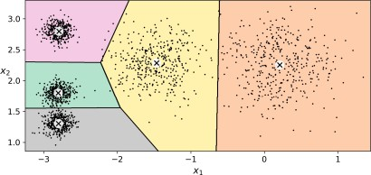
K-means
- The K-Means algorithm is a simple algorithm capable of clustering this kind of dataset very quickly and efficiently, often in just a few iterations.
But how does it work?

Slide 8

K-means
- Assuming data was distributed in this manner via a 2-dimensional plot
Example 1

Slide 9

K-means
Since k = 3, we want 3 clusters
We pick 3 random instances to be centroid, representing each group.
3 centroids (k=3)
Example 1

Slide 10
K-means
- Based on distance between centroid and data points, the clusters are formed.
Example 1

Slide 11

K-means
- New centroids are formed
Based on average of point values for each group
and so on until the three centroids don’t change from iteration to the other
New instance
Example 1

Slide 12
K-means
- let’s consider a case where data points are a bit more sporadic
Example 2

Slide 13
K-means
- By picking random instance from each group
centroids
Example 2

Slide 14
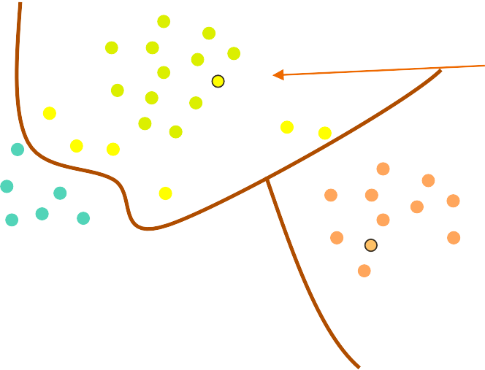
K-means
- Now update centroid
Find the mean

Slide 15
K-means
- Give new labels

Slide 16
K-means
- Give new labels
Find the mean

Slide 17
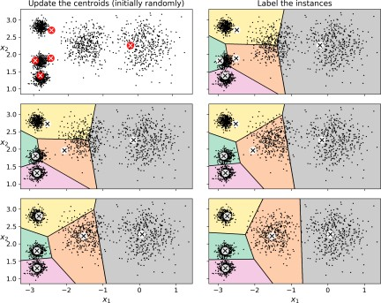
K-means
Can you guarantee that it will ALWAYS give you the right Clustering ?

Slide 18
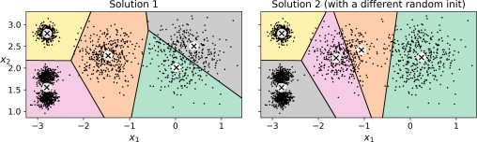
K-means
Can you guarantee that it will ALWAYS give you the right Clustering ?
No, it depends on the random Centroid we picked, and the nature of our data

Slide 19
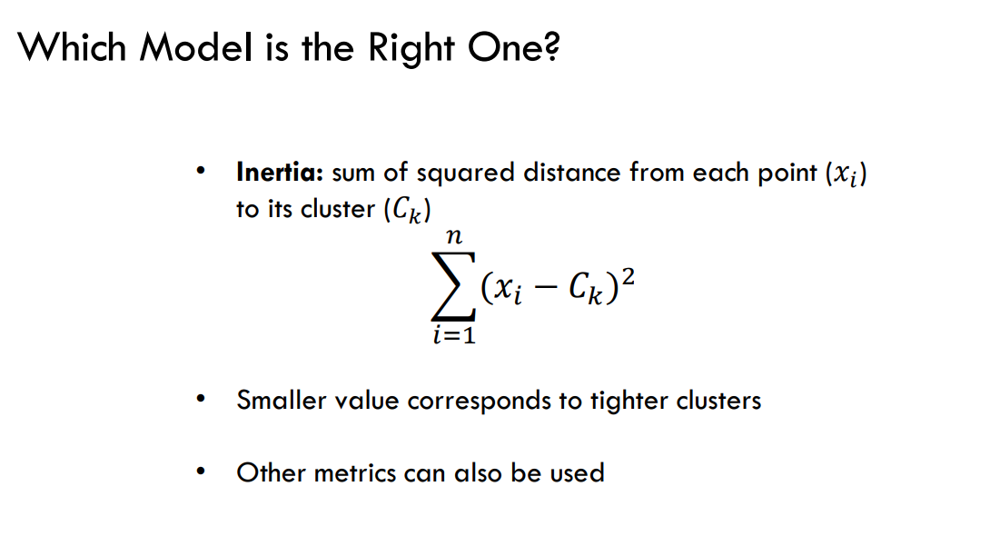
K-means

Slide 20

K-means
Centroid Initialization Methods
If you happen to know approximately where the centroids should be You can
These are the centroid

Slide 21

K-means
Centroid Initialization Methods
Another solution is to run the algorithm multiple times with different random initial‐izations and keep the best solution.
By defult it is equal to 10, which means that the whole algorithm described earlier
actually runs 10 times when you call fit(), and Scikit-
Learn keeps the best solution

Slide 22
K-means
How exactly does it know which solution is the best ?
Using the model’s inertia: this is the mean squared distance between each instance and its closest centroid , summing these squares across one cluster Less is better

Slide 23
K-means
Can we use inertia ?
No
inertia is not a good performance metric when trying to choose k since it
keeps get‐
ting lower as we increase k. Indeed, the more clusters there are, the closer each
instance will be to its closest centroid, and therefore the lower the inertia will
be.

Slide 24
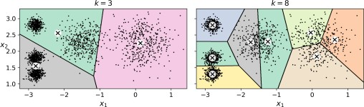
Finding the Optimal Number of Clusters

Slide 25
Finding the Optimal Number of Clusters
Inertia = 119.3
Inertia = 653.2

Slide 26
Exercise
What do we mean by mini batch k-means

Slide 27
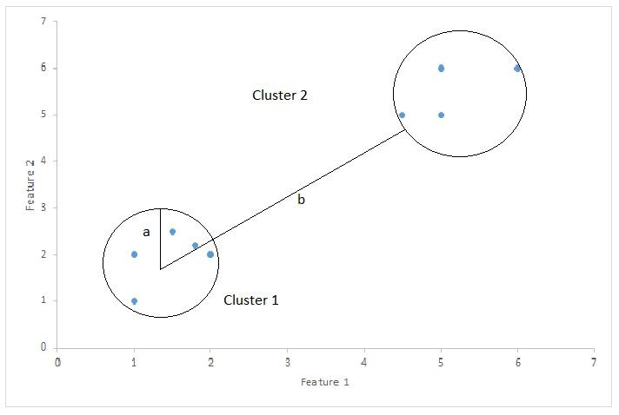
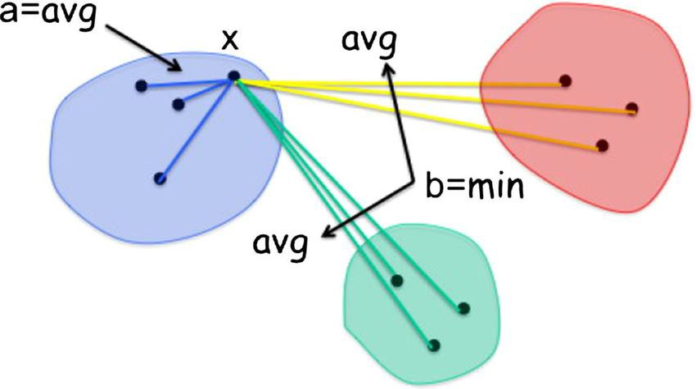
Cluster Evaluation - silhouette score pt.2
which is the mean silhouette coefficient over all the instances
E.g.1
E.g 2

Slide 28
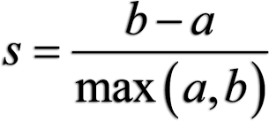
Cluster Evaluation - Silhouette score
which is the mean silhouette coefficient over all the instances
Notes:
a= average intra-cluster distance i.e the average distance between each point within a cluster.
b= average inter-cluster distance i.e the average distance between all clusters.

Slide 29
Cluster Evaluation - silhouette score pt.2
. The silhouette coefficient can vary between -1 and +1:
a coefficient close to +1 means that the instance is well inside its own cluster and far from other clusters,
a coefficient close to 0 means that it is close to a cluster boundary, and coefficient close to -1 means that the instance may have been assigned to the wrong cluster

Slide 30
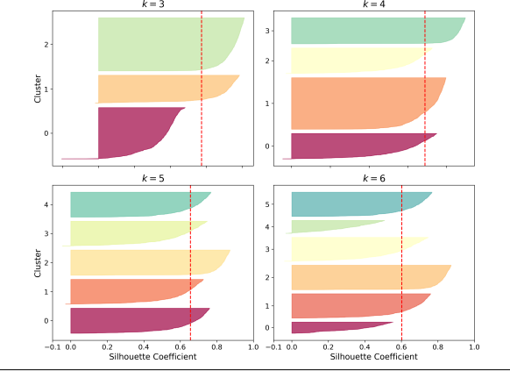
Exercise
Based on s coefficient which k is better ?

Slide 31
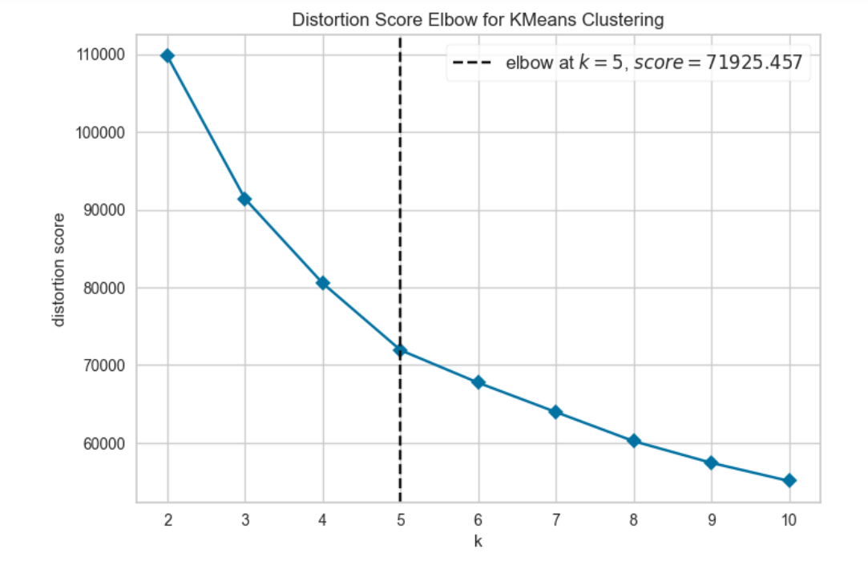
Cluster Evaluation - Elbow Method
- Uses WCSS as distortion score (Within-Cluster Sum of Square)

Slide 32
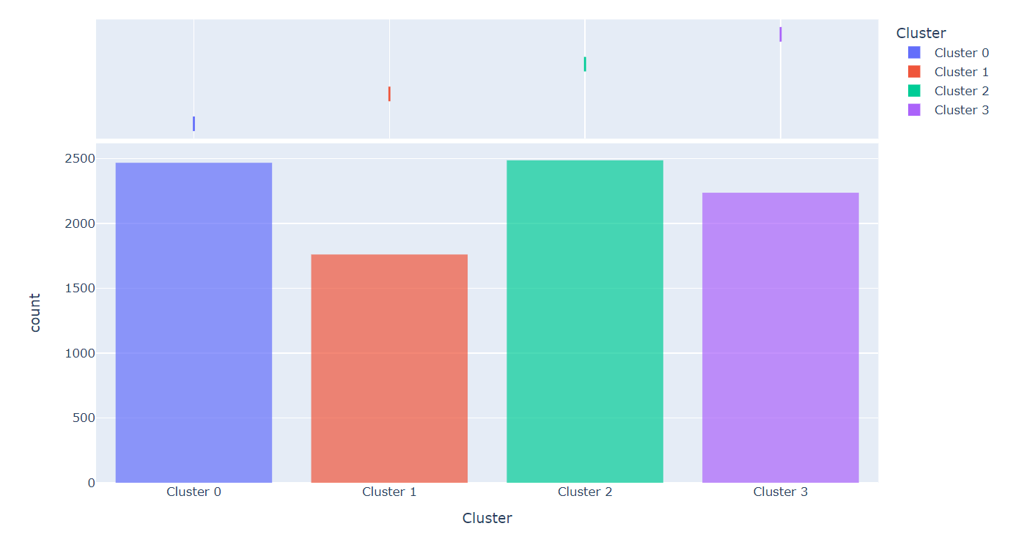
Cluster Evaluation – Histograms
Count number of data points for each group

Slide 33

Hierarchical Clustering
Tree based method
Observations are divided into a tree-like structure
Using distance as a measure
Efficient and suitable for specific kinds of data clusters
Two types
Agglomerative
Divisive

Slide 34
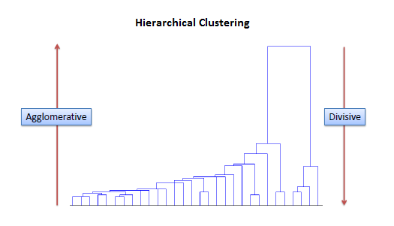
Hierarchical Clustering

Slide 35
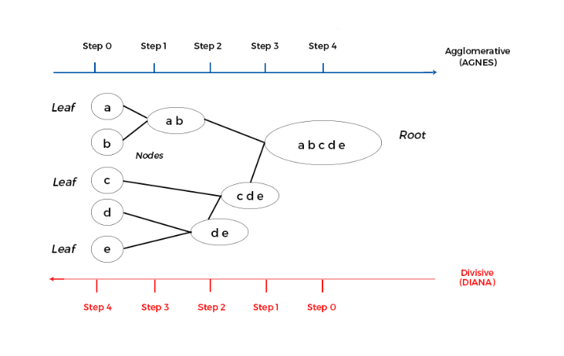
Hierarchical Clustering

Slide 36
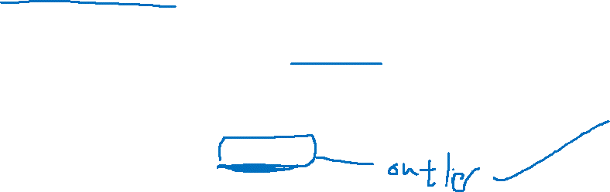
Density-based - DBSCAN
For each instance, the algorithm counts how many instances are located within a small distance ε (epsilon) from it. This region is called the instance’s ε neighborhood.
If an instance has at least min-samples instances in its ε-neighborhood (including itself), then it is considered a core instance. In other words, core instances are those that are located in dense regions
Any instance that is not a core instance and does not have one in its neighborhood is considered an anomaly.

Slide 37
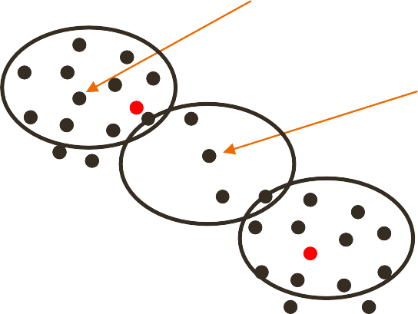
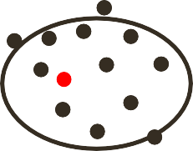

Density-based - DBSCAN
- Assuming min-sample =5
Core instance
Not core
instance

Slide 38
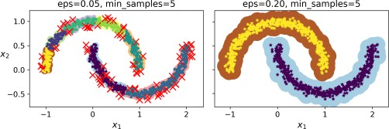
Density-based - DBSCAN

Slide 39
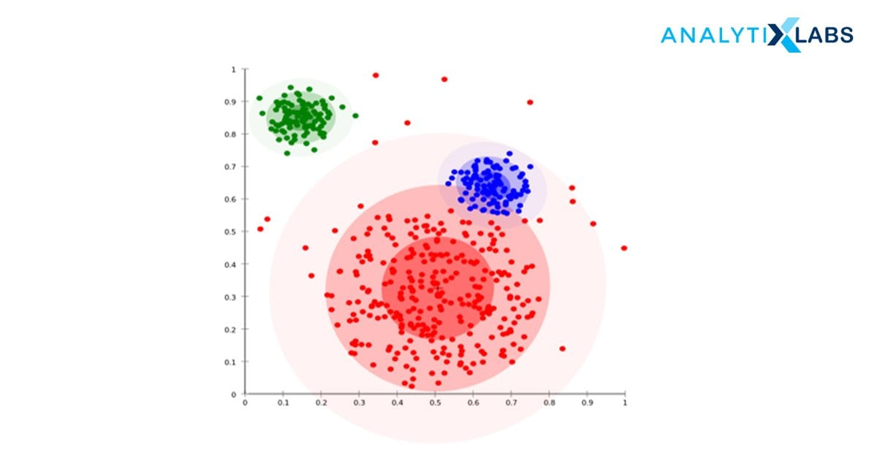
Distribution-Based Clustering

Slide 40
Thank you
Notes:
a

